Slide 1
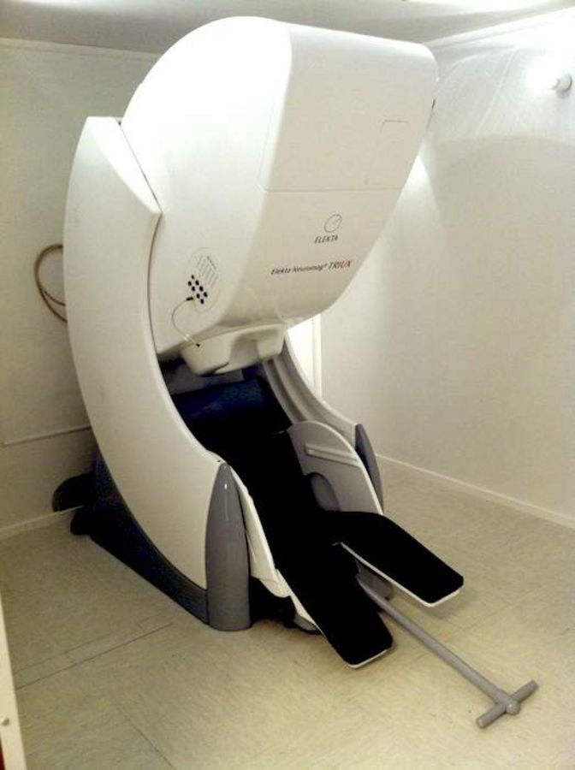
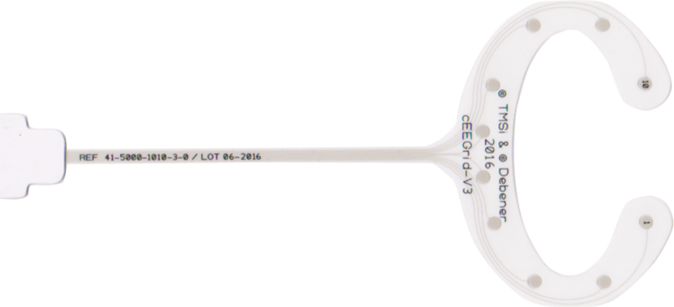
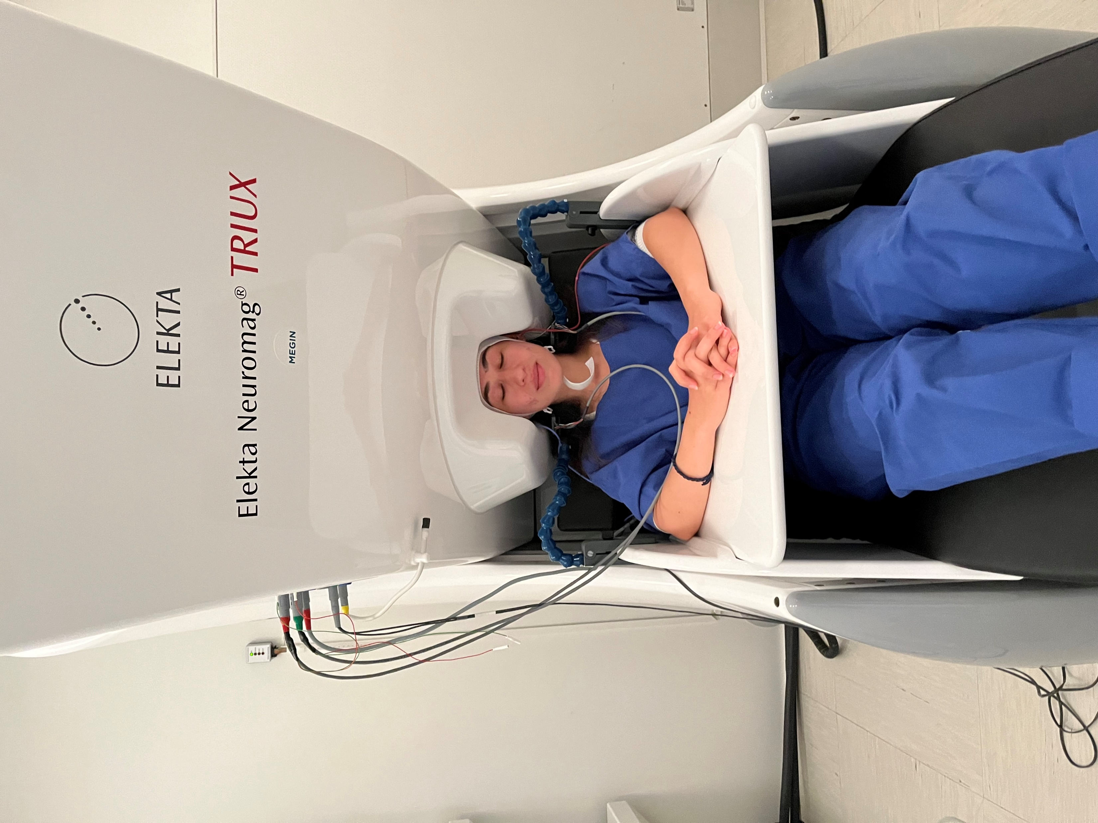
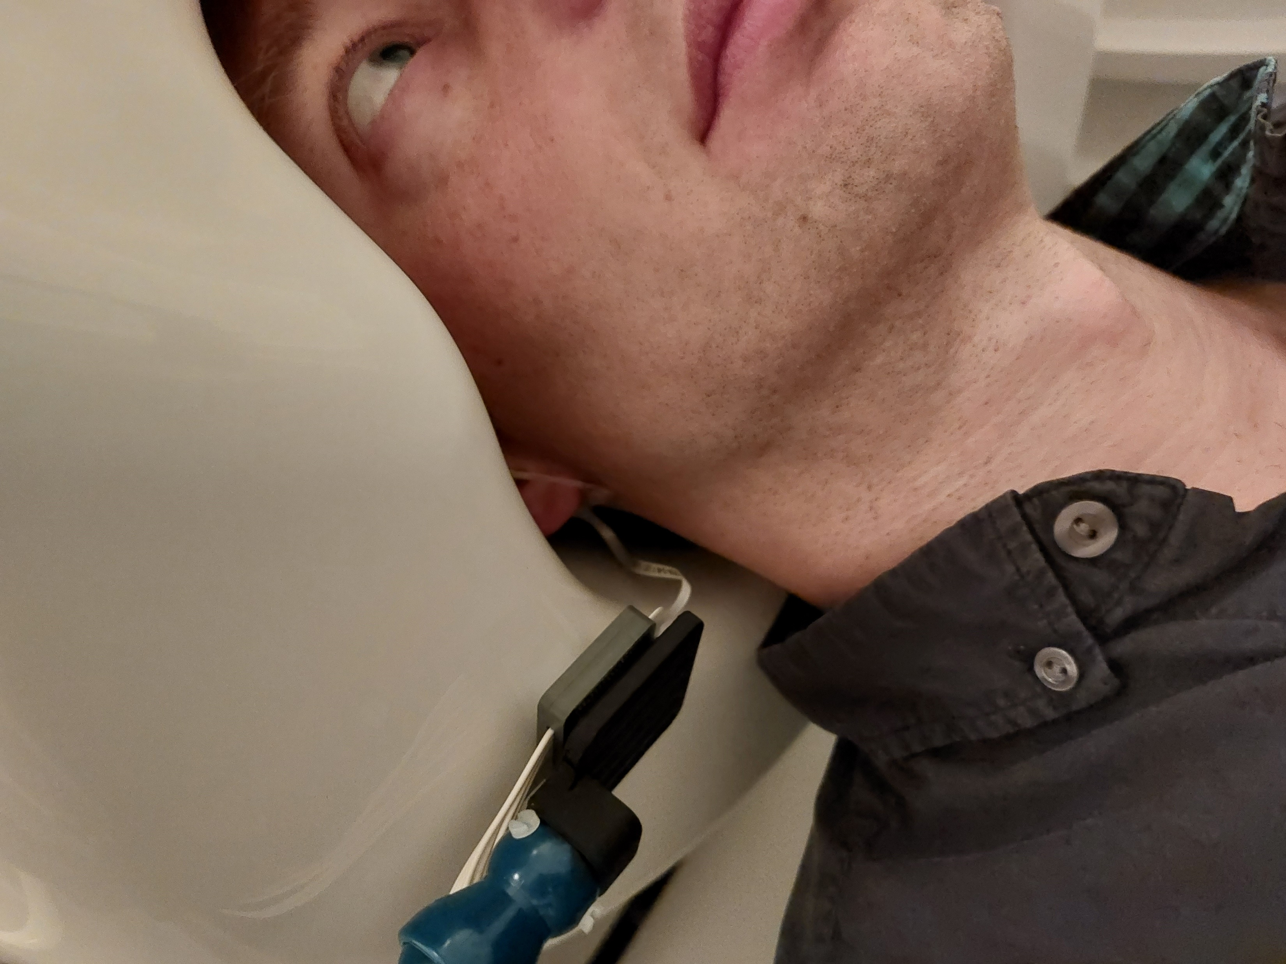
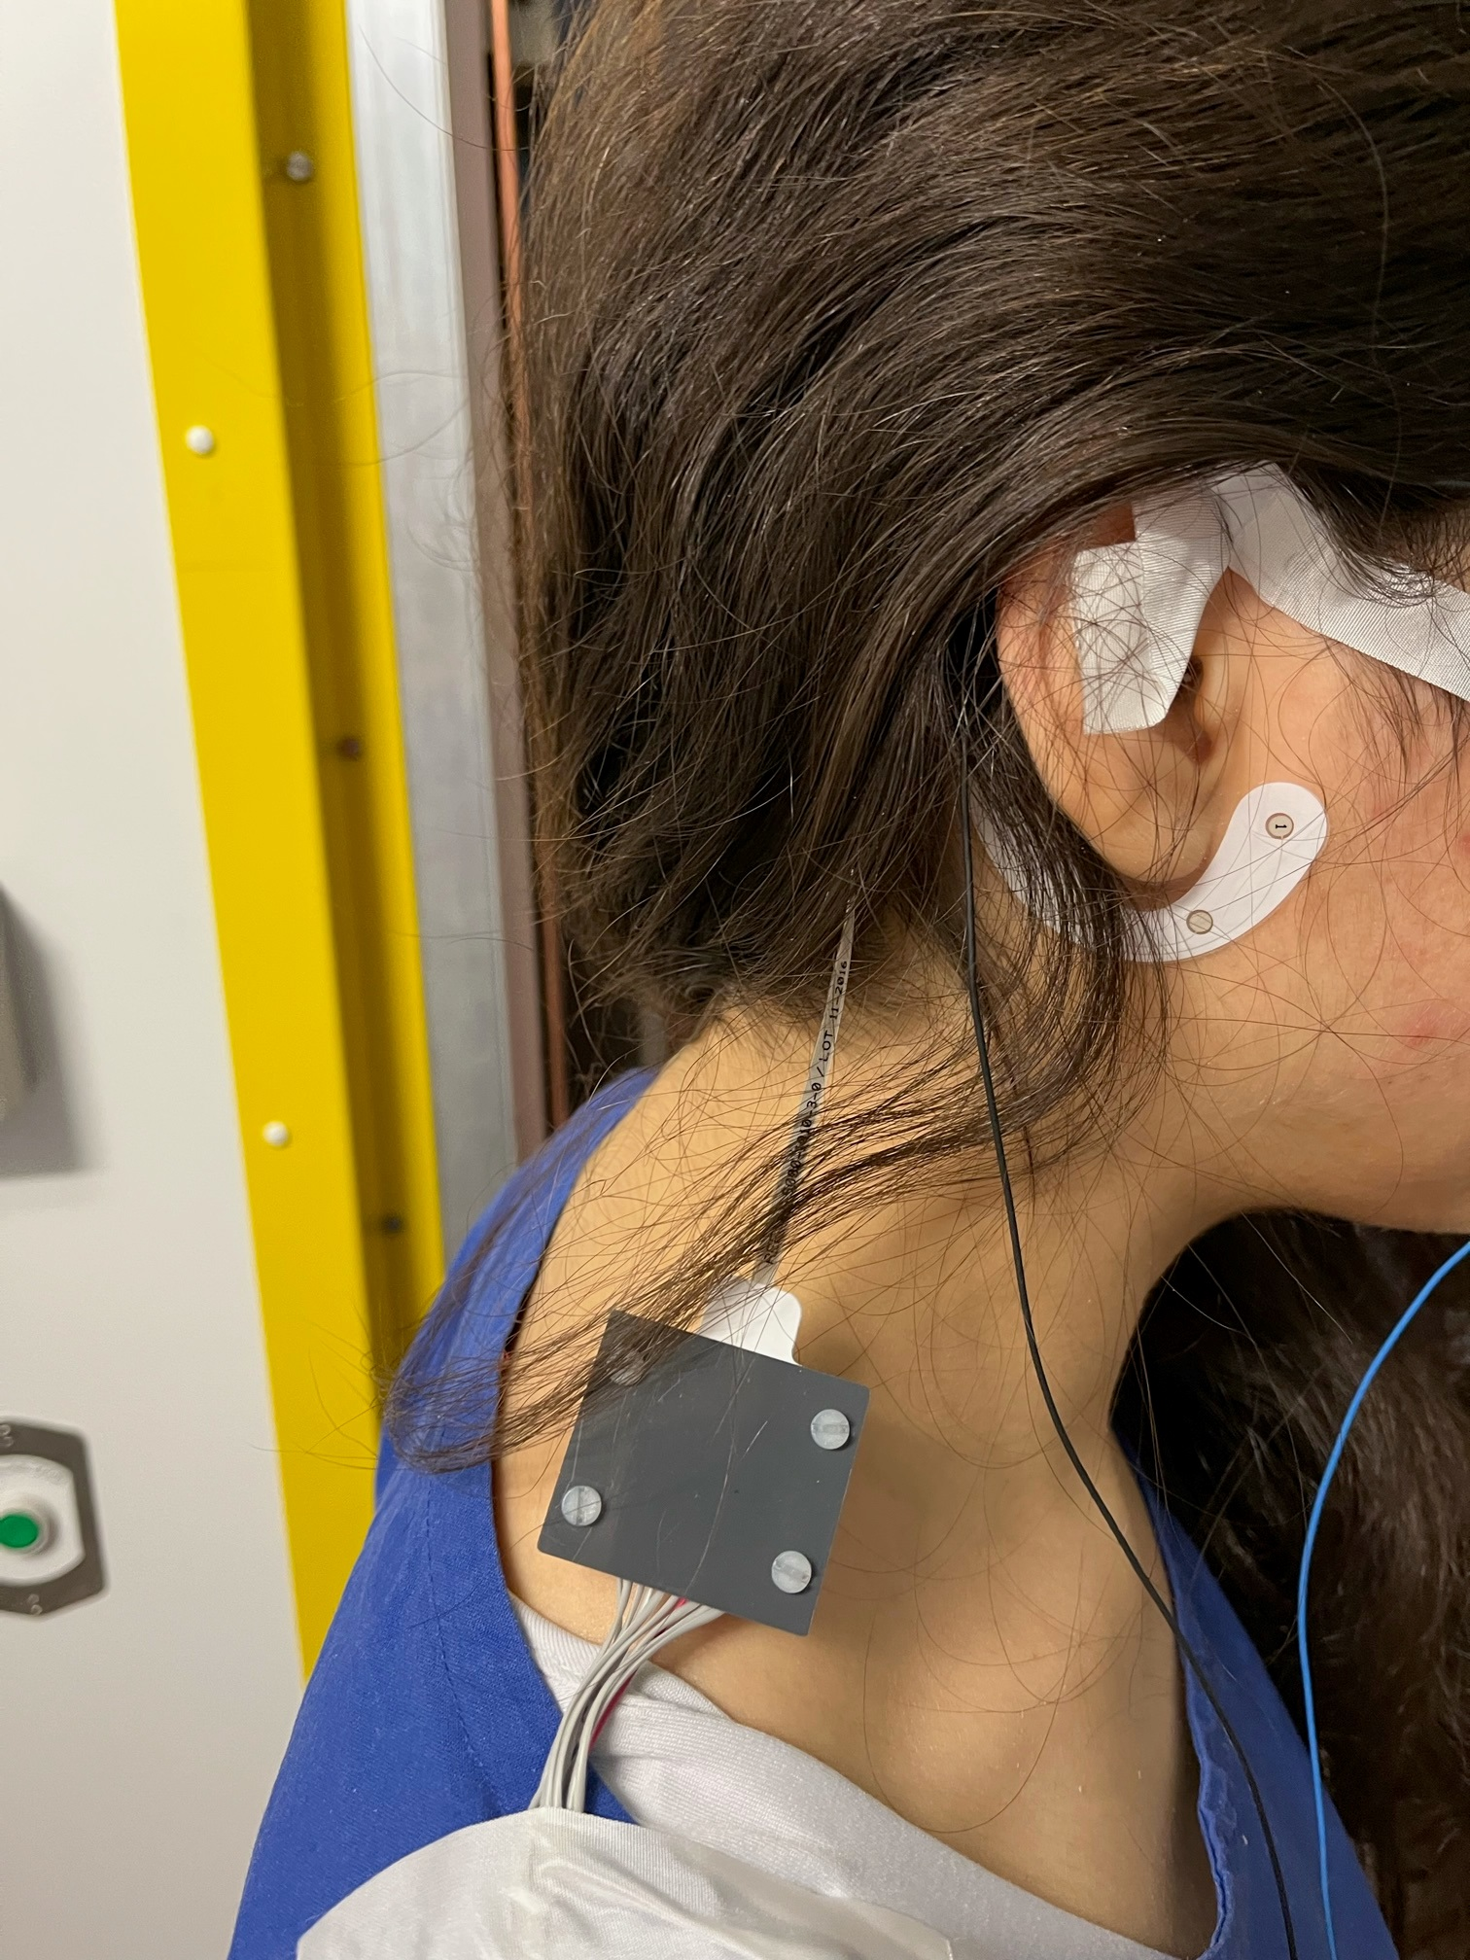
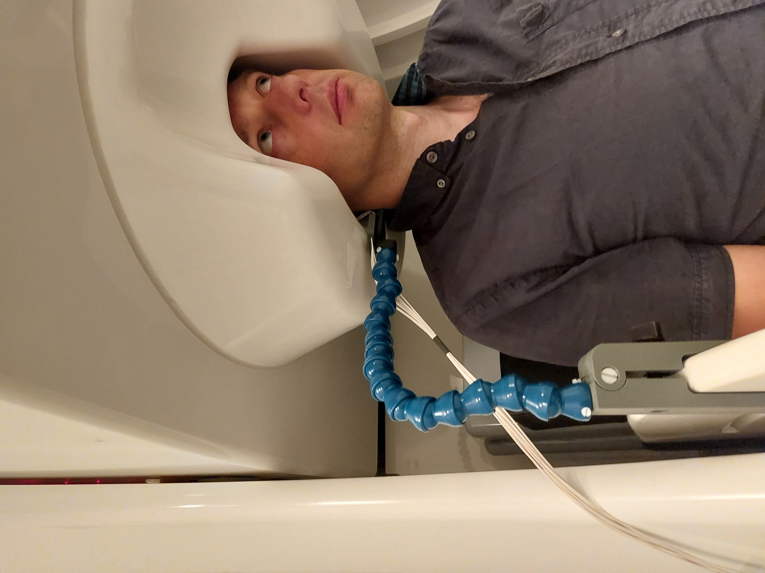
Ear-EEG compares well to MEG in recording auditory ERPs?
Till Habersetzer, Andreas Spiegler

Slide 2
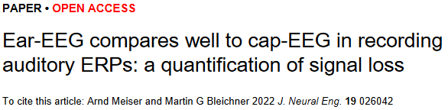
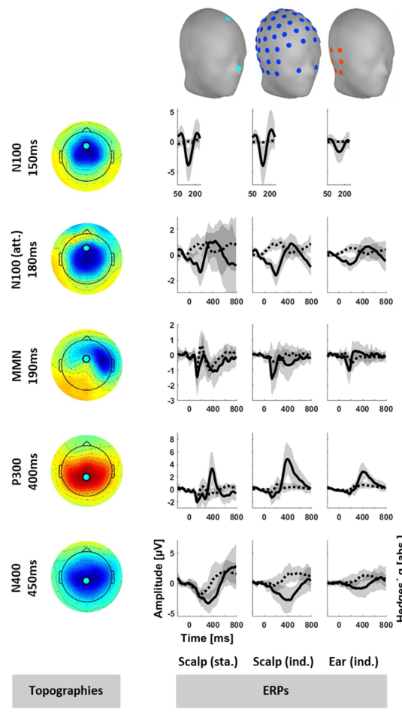
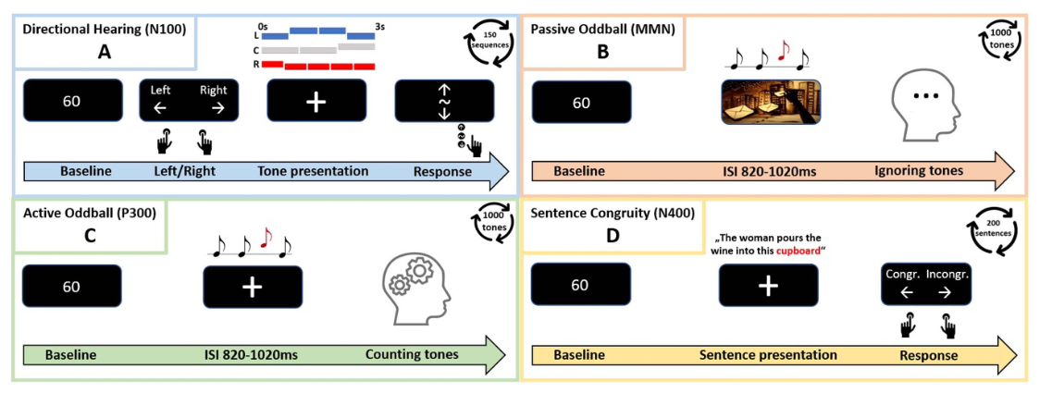
Ear-EEG compares well to MEG in recording auditory ERPs?

Slide 3
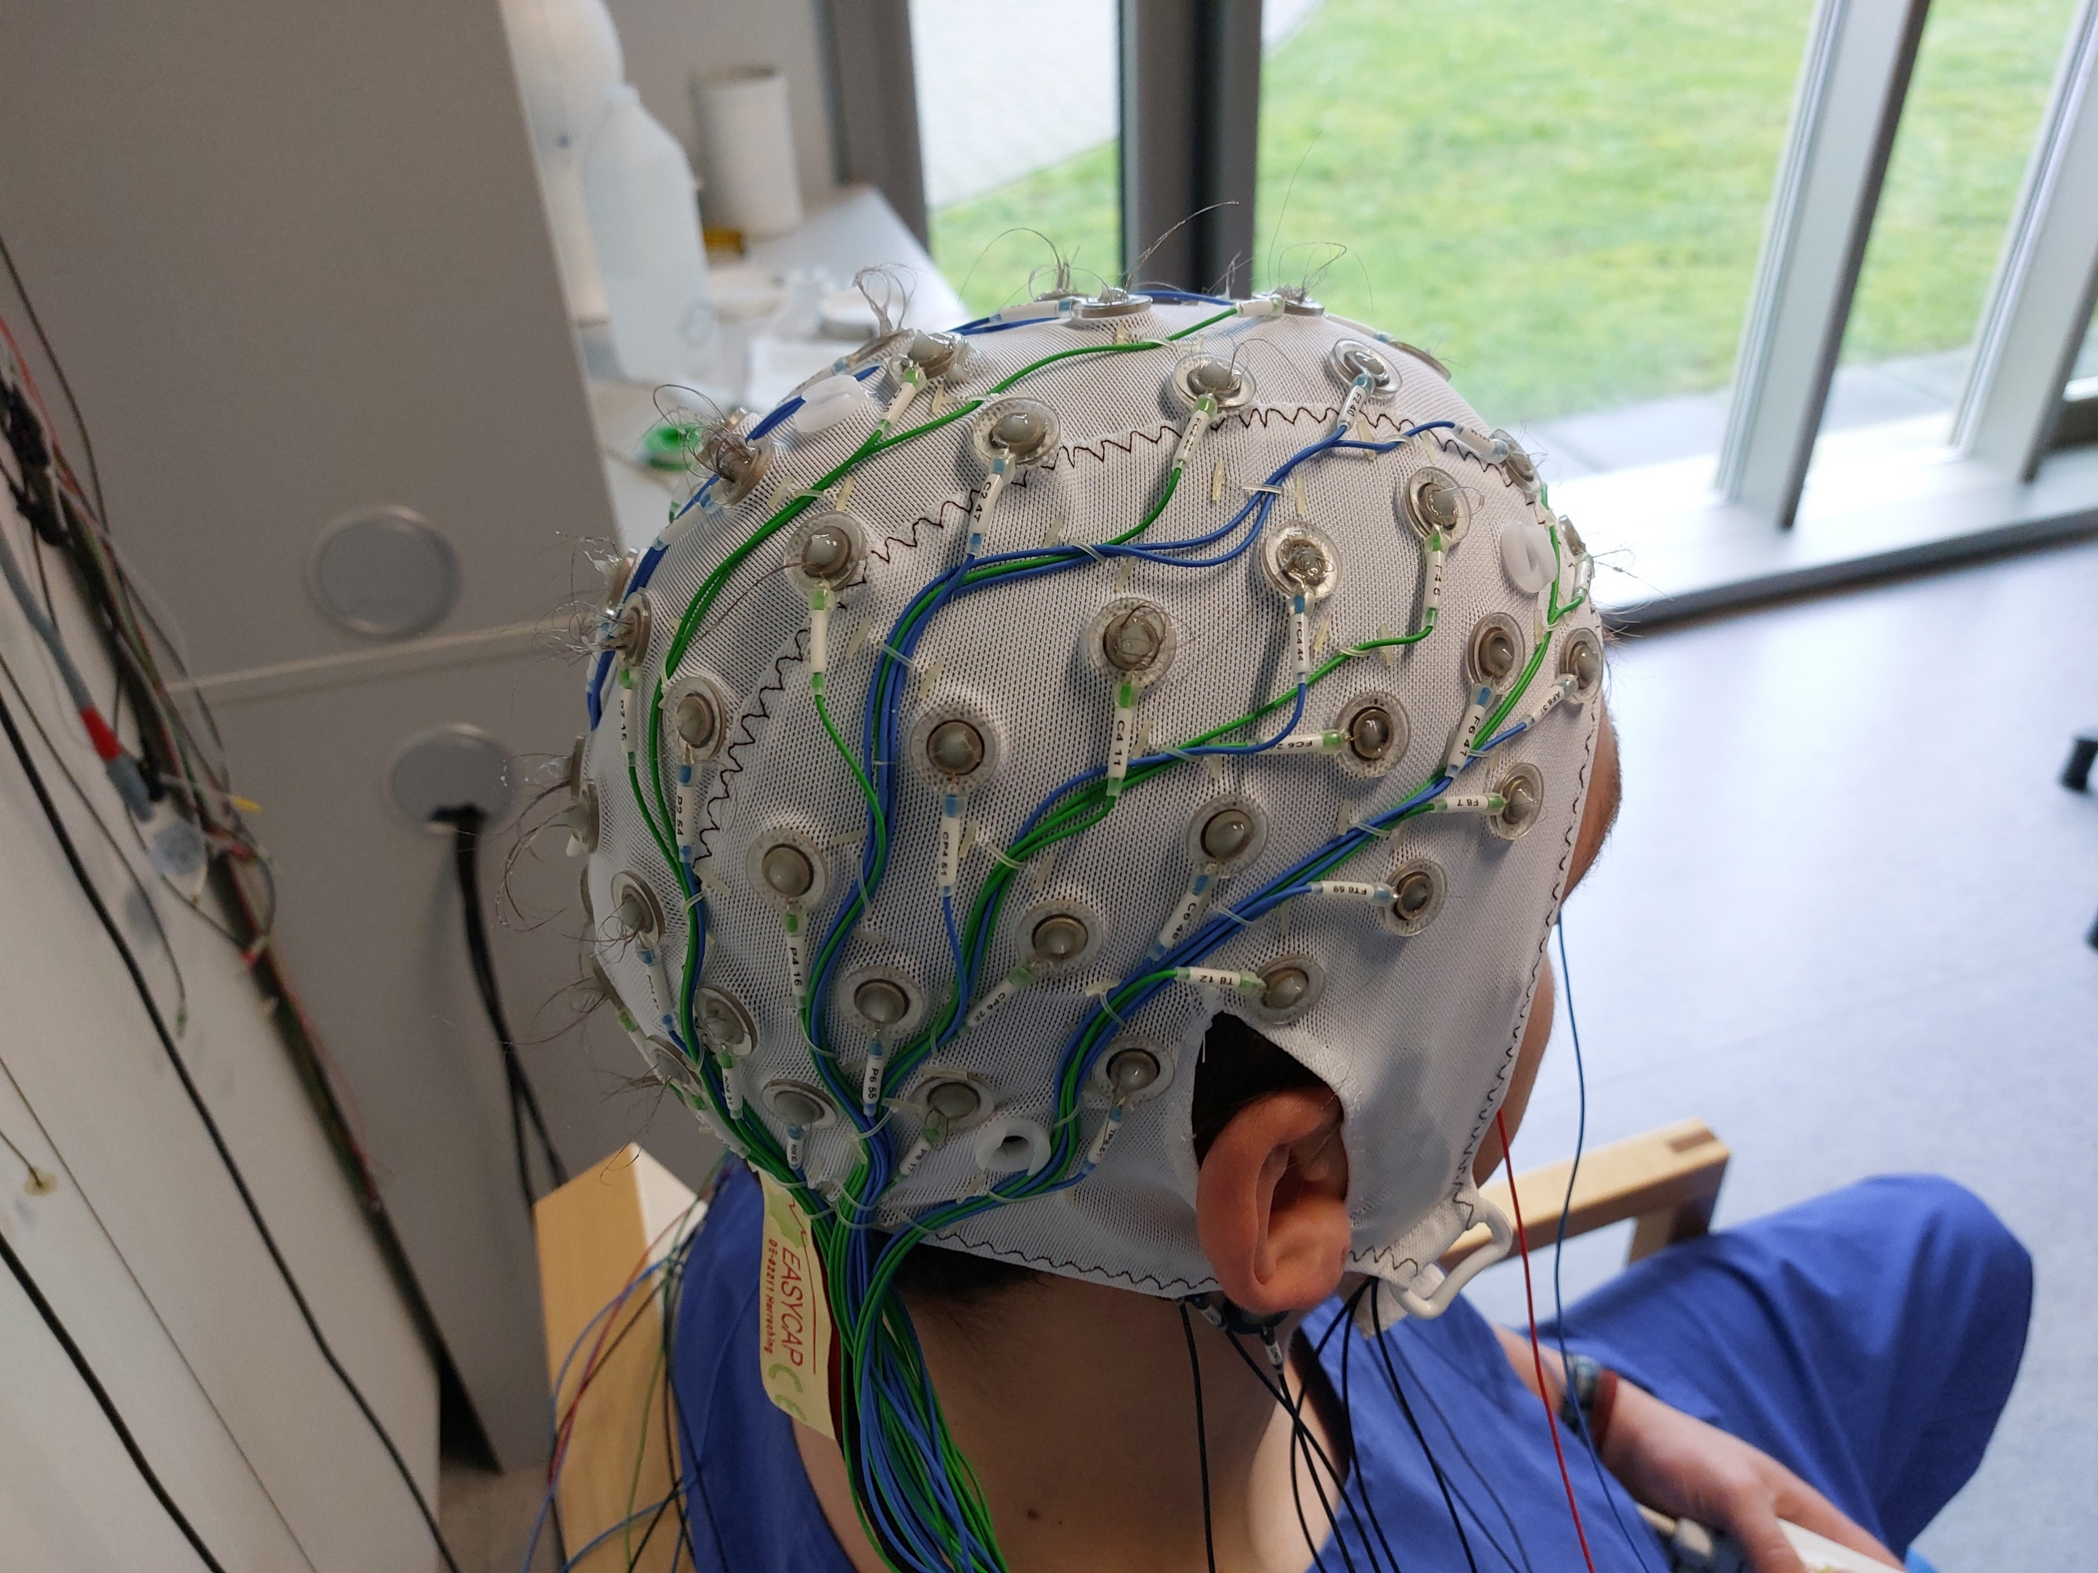
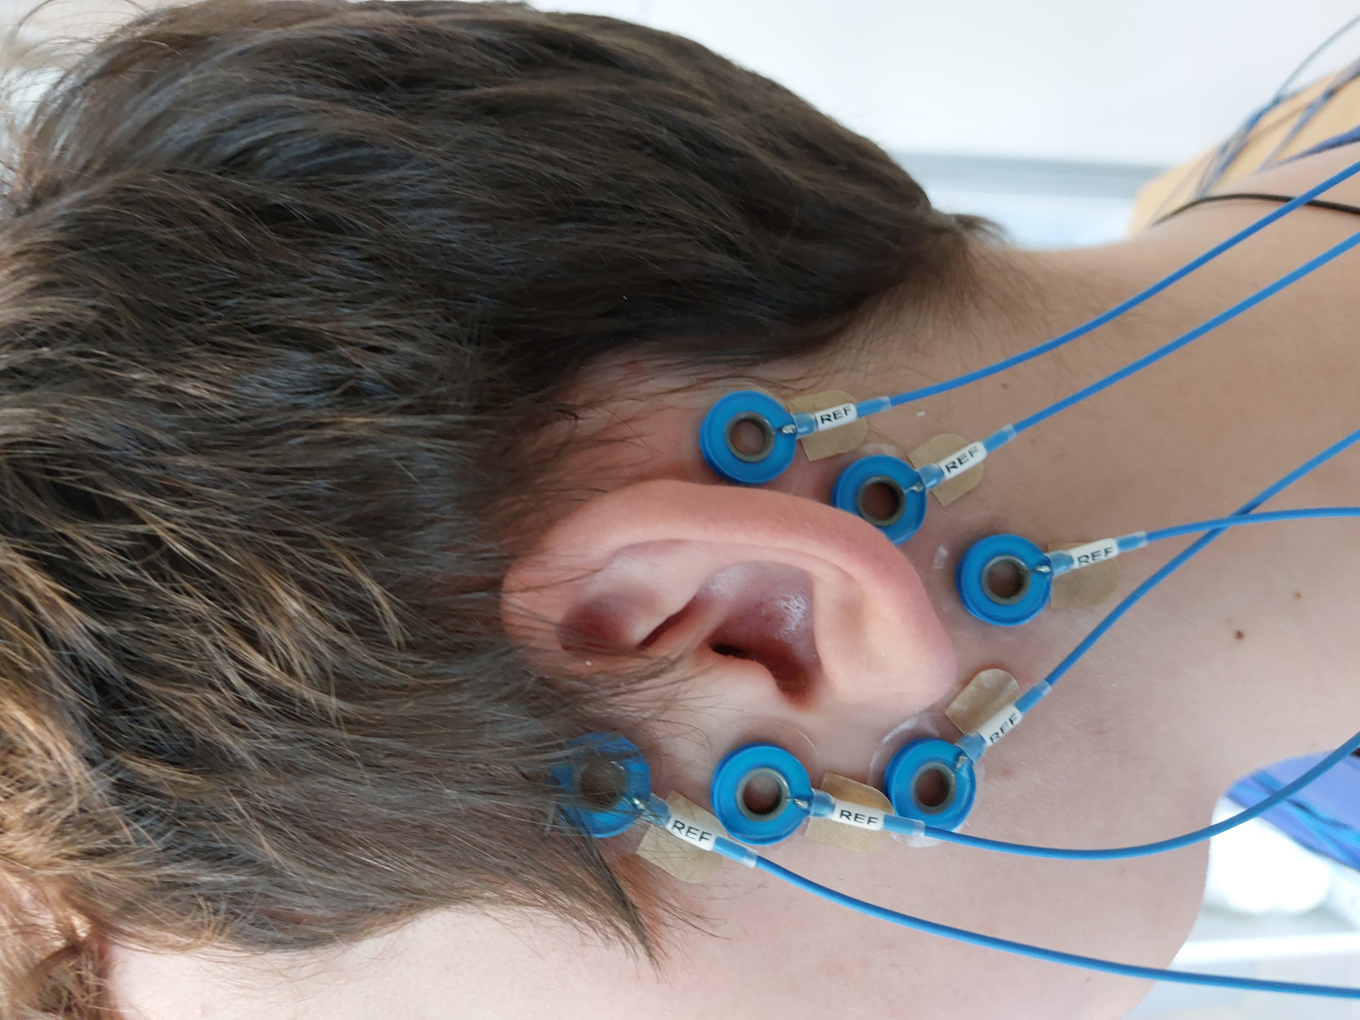
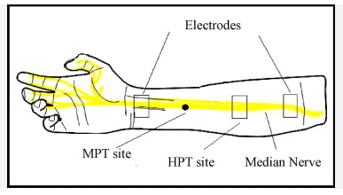
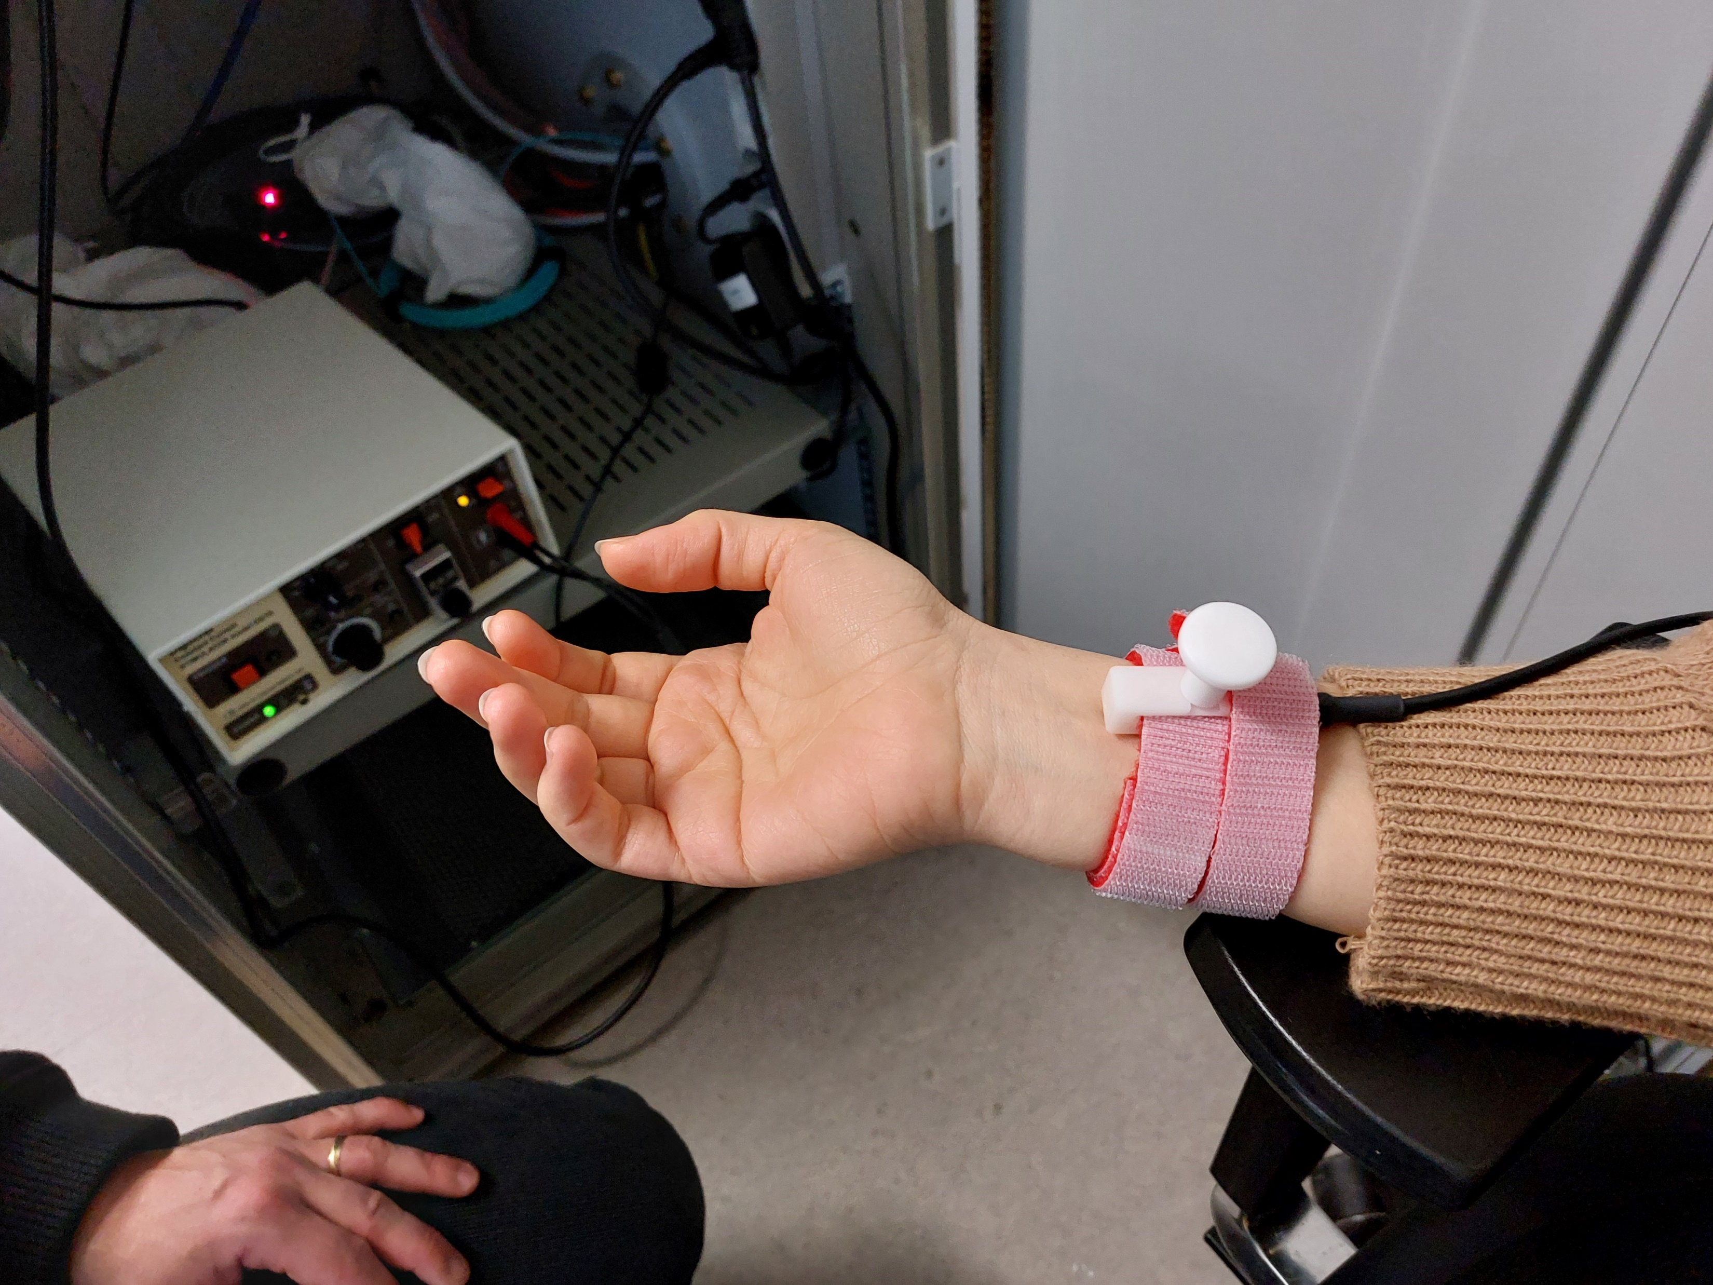
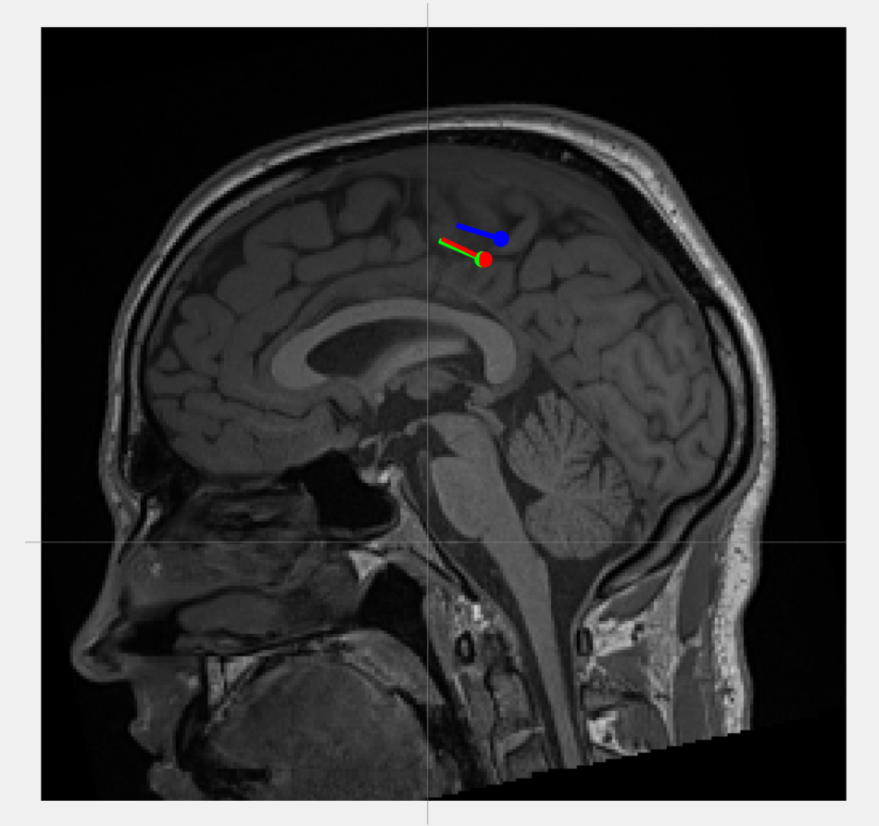
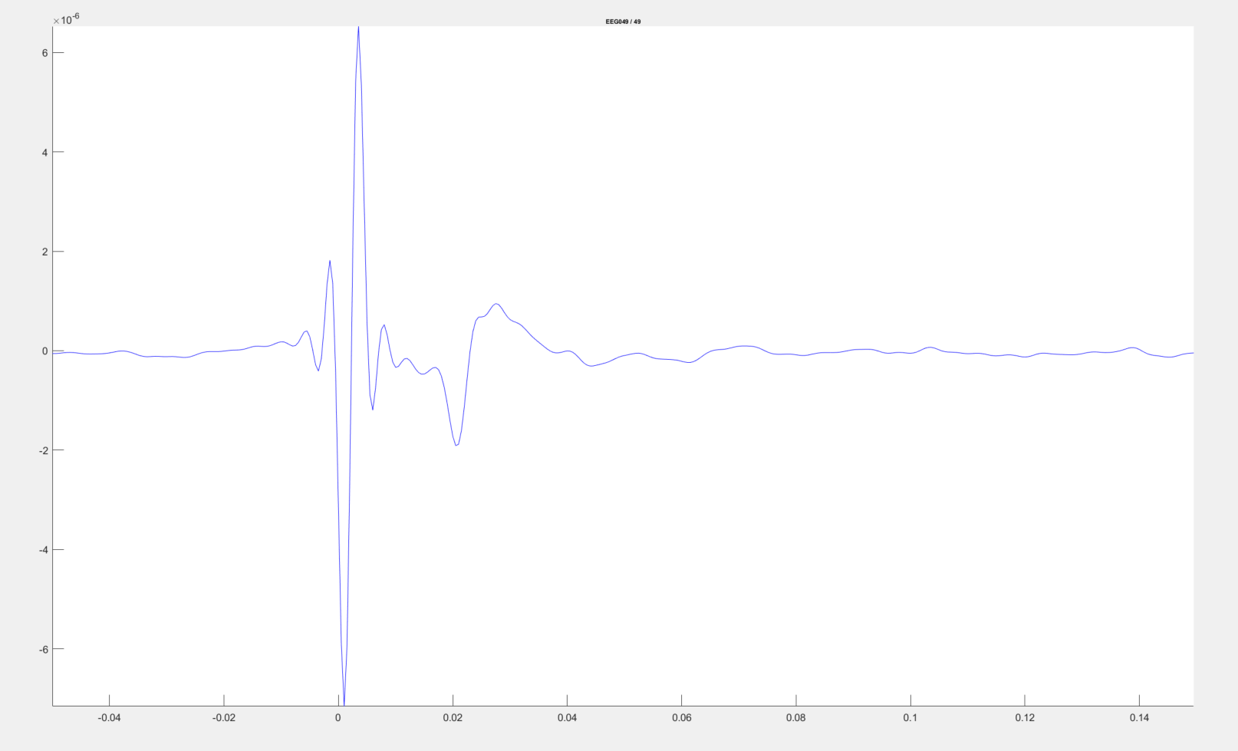
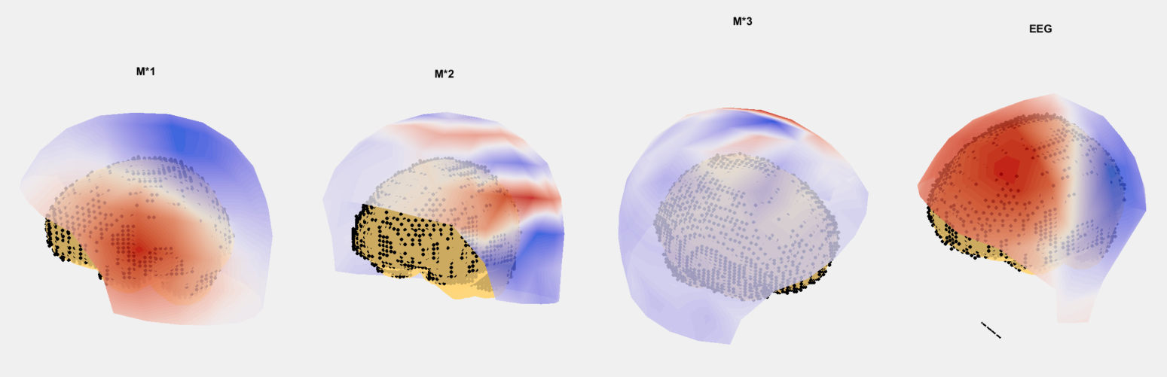
Last practical – median nerve stimulation

Slide 4
Contraindications - Who can not participate?
To avoid magnetic interactions – especially with metals – because they reduce the measurement accuracy, no metals should be worn on your body during the measurements.
No metallic implants, they also have the possibility to be ferro magnetic (Retainer!!)
Tattoos (also permanent make-up, especially shoulder, head area) can contain color particles with metallic parts in it.
No pacemakers, neuro-stimulators, insulin pumps or hearing devices.
Also cosmetics such as mascaras, rouge or even styling gel can contain metal. Please avoid using those on the day of measurement.
But you can also ask your fellow students if they would like to participate and be measured
We are planning to include an anatomical MRI of your brain in this project

